Slide 1
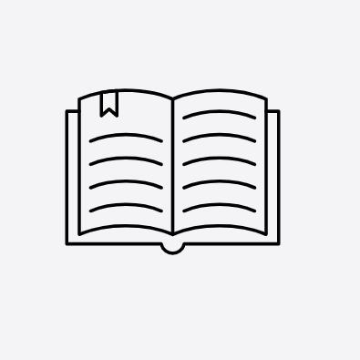
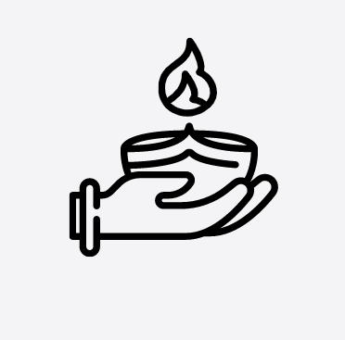

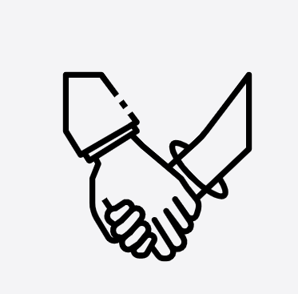

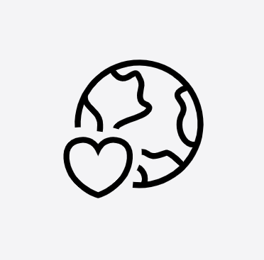



The 8 Essentials Curriculum at Runnymede St.Edward’s

Slide 2
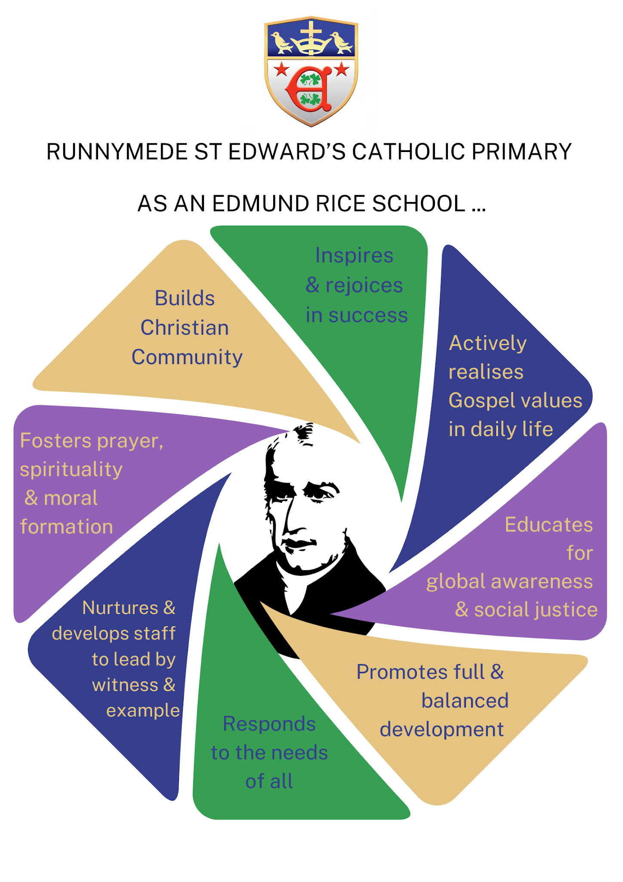

Slide 3

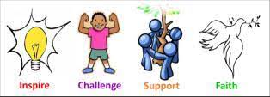
Prayer of Thanks for Blessed Edmund Rice
Heavenly Father, hear our call.
Guide us and bless us, one and all.
With Edward’s strength and Edmund’s grace,
Help us love you in this place.
Proud in spirit, strong and true,
Working hard in all we do.
Joining in with open hearts,
Treating others as thou art.
Jesus, lead us in your light;
Mary, guide us to live right.
Now and always, by your hand,
Faithful Edwardians we stand.

Slide 4
The 8 Essentials 0f Edmund Rice Education
Evangelising the modern world
Participating in the mission of the Catholic Church by bringing the Good News of Christ to all aspects of the life of the school community, and in dialogue with youth and contemporary culture, thus fulfilling the specific calling of the Congregation of Christian Brothers:
‘The Evangelisation of youth through the Apostolate of Christian Education’
Concern for the whole person
Centering the curriculum, opportunities and challenges of the school on the balanced and integrated developments of its students, and staff, across all the positives dimensions of personal growth- religious, moral, intellectual, cultural, physical and social.
Striving for excellence
Encouraging each individual to use his or her talents to the full, whether academic, cultural, or physical, and pursuing the highest standards in all aspects of learning, teaching and extracurricular endeavours.
Promoting the spiritual
Nurturing a living faith, fostering Christian spirituality, educating in Gospel-based values, living beyond the material dimension.
Building a Christian community
Growing as a school community in which the quality of care and relationships is Christ-inspired, based on mutual respect, self-sacrifice, and fully human dignity.
Education as a Christian calling
Valuing and enabling the role and vocation of Christian teachers and support staff as a calling from God and a sharing in the Church’s mission.
Compassion for those in need
Showing, in the Blessed Edmund Rice, particular love and concern towards the weakest members of the school community and reaching out beyond the school in compassion and practical action for the marginalised both locally and internationally.
Education for justice
Inspiring the minds and hearts of the young to care for all of God’s creation and build a more just society. God’s kingdom on earth, and developing in them the talents for active citizenship and transformational leadership.

Slide 5
The Importance of the 8 Essentials of Edmund Rice
Runnymede St Edwards Catholic Primary is one of 11 English schools which retain links the Edmund Rice Network. Born in Callan, Ireland, in 1762, Edmund Rice founded his first school in Waterford in 1802. Such was the standard of education provided by Edmund and his colleagues, they were quickly invited to start similar schools across Ireland. Before long, Edmund’s ‘brothers’ were travelling to England and even Australia to establish their model for Catholic education.
In 1808 Edmund and seven men took religious vows and, in 1820, the Congregation of Christian Brothers was approved by the Holy See.
As the Congregation evolved following Edmund’s death in 1844, their mission inevitably changed. By the late 20th Century, as the Christian Brothers continued to be drawn to the most marginalised across the world, they moved out of teaching in the English schools and focused on outreach ministry and education in the developing world.
Today, all of the English Edmund Rice schools share a set of statements which explain the ongoing connection to the charism of Edmund Rice called the Essential Elements of an Edmund Rice school.
In order for our pupils to understand the Essential Elements, we have put them into a wording that will be more familiar and meaningful.
Evangelising the Modern World -Celebrate Jesus’ values in all we do 5. Concern for the Whole Person -Be the best I can be
Promoting the Spiritual -Grow, through talking about our beliefs 6. Striving for Excellence -Create a better future for everyone
Building a Christian Community -Build an inclusive community in 7. Education as a Christian Calling -Live by Jesus’ example
school and beyond
Compassion for those in Need -Help people who need it 8. Education for Justice -Care for one another and our world

Slide 6
An Introduction to Our 8 Essentials Curriculum
Our 8 essentials curriculum has been designed by Runnymede St Edwards Catholic Primary to provide a bespoke, motivating and exciting learning experience. Inspired by the founding vision of Blessed Edmund Rice, our curriculum aims for pupils to become articulate learners with high aspirations. We place an important emphasis on developing the whole child, supporting them to be resilient, healthy and open-minded human beings.
All our subjects are centrally driven by the 8 Essentials of Edmund Rice, these are the foundations of everything we do. We have adapted the wording of the essentials so that learners can fully connect with their meaning. Each essential has a Christian foundation, that supports our pupils through their academic journey and promotes both character and spirituality for all. Each Essential will be woven into a specific unit of work within the subject disciplines to ensure that our Young Edwardians at Runnymede St Edward's Primary become loving, compassionate, tolerant and successful young people.

Slide 7
The 8 Essentials For Our Young Edwardians
Grow, through talking about our beliefs
Create a better future for everyone
Build an inclusive community in school and beyond
Help people who need it
Celebrate Jesus’ values in all we do
Care for one another and our world
Live by Jesus’ example
Be the best I can be

Slide 8

The 8 Essentials in English
-A range of Christian Values woven throughout our text driven curriculum. -RE lessons -Assemblies -Class values -Listening to Bible stories and retelling -Exploring themes such as forgiveness, kindness, honesty in texts -Sensory stories and props -Key vocabulary cards with visuals | -Whole school writing projects -Themed writing weeks -High quality children’s literature used throughout -Steps to Read (Y2-Y6) -Circle time -Assemblies -Talking partners, -Reflection time -Oracy opportunities -Storytelling -Show and tell -Structured talk frames | -Book Fair -Poet/ author/illustrator visits - Liverpool -Children's Festival of Reading -Links with other primary schools -Strong relationships with parents to develop effective reading routines at home -Parent Reader volunteers. -Collaborative storytelling and shared writing -Group discussions, drama, presentations -Visual turn-taking and communication aids | -A range of issues studied pertaining to supporting those who may need help and support in our school and home community -Reading Buddies -Daily Readers -1/1 tuition to support -RWI readers -Role play and social stories -Picture sequencing -Simplified writing frames
-A variety of themed days and events to celebrate Reading and Writing -Wow Words - to promote sophisticated vocabulary -Purple Polish Time editing, improving writing -Reader and Writer of the Month KS1 &2 -Mystery Reader Y1 -English Ambassadors -Small-step targets -Aalternative ways to show learning (oral, ICT, scribe) | -Handwriting expectations -RWI Phonics taught across KS1 -Text driven approach -Positive verbal feedback approach -Read to Write in EYFS, KS1 and KS2 -Eco projects -School council -Community actions -Persuasive writing -Speeches -Reports on change -ICT, or voice recording instead of long writing | -Teacher Feedback on their favourite book/author and current read -Teacher book recommendations retrieval opportunities -Subject planning and delivery is sequenced and provides retrieval opportunities -Diary writing, character analysis, reflective writing -Role play and moral stories -Social stories about choices | -BHM - studying Black authors poets and writing for a range of purposes -Reading and writing for a range of cross curricular purposes (RE, History) -British Values - Respect and Tolerance -Non-fiction reports, explanations, persuasive texts about caring for the environment -Simplified texts with pictures -Hands-on learning and visuals -SMSC woven throughout

Slide 9

The 8 Essentials in Maths
Maths will provide the foundations for our pupils to understand and appreciate the world around them. Timelines and dates concerning the liturgical calendar. Investigations/data/% concerning our faith | ‘Discover’ tasks to make links with maths in the real world A focus on ‘the learning’ not the ‘right answer’ Lessons are built around discussion and reasoning (Share / Think Together) | Liverpool Maths Party Links with other primary schools TT Rockstars - Y2-6 Maths workshops CPD approach to support learning Newsletters and specific Maths Newsletters Volunteers/students Maths Hub Parents talking about maths in their jobs | PSHE - Money Matters Application to maths in real life contexts NSPCC Number Day The use of maths to support charities- itemising food/ monetary donations
Reasoning opportunities woven throughout the curriculum Encouraging Maths Vocabulary and partner talk/discussion Mathematician of the Month KS1 &2 Promotes a growth mindset – children learn that everyone can succeed and mistakes are part of learning Individual liberty - being able to make mistakes and learn from them Taking risks in problem solving | Problem solving and ‘Prove it’ tasks Pattern seeking and ‘Show me a different way’ tasks Peer marking and collaboration tasks Journaling to demonstrate a CPA approach Using maths to discover and analyse jobs/vocations, such as sports/transport/food industry Application to real-life contexts (jobs, finance, problem solving) | Power Maths approach used throughout Retrieval opportunities through Power Ups, Flashback 4 and Basic Skills Teacher modelling in Shared Task Support through collaborative learning Inclusivity Maths Ambassadors | Use of maths in the wider world Rule of Law - British Values Turn -taking British values - Mutual Respect ‘Maths Masters’ - children assigned to further support or be supported

Slide 10

The 8 Essentials in Science
Our learners will value the discipline of Science and its impact on the world around them. Child-led investigations supported by discussion and questioning. Promote curiosity through reading and awe-inspiring experiences (e.g. Science Week). Structured talk, visuals, and accessible texts for all learners. | Creating a sense of awe and wonder Whole School Science Week Child-led investigations supported by discussion and questioning. Promote curiosity through reading and awe-inspiring experiences (e.g. Science Week). Structured talk, visuals, and accessible texts for all learners. | Links with families, STEM experts, and other schools. Promote Science as accessible to all. Engage all families and provide diverse role models. | Collaborative learning builds teamwork and empathy. Teach environmental awareness, safety, and wellbeing. Mixed-ability groups and real-life contexts support all pupils.
Encourage pupils to think and speak like scientists. Emphasise vocabulary, enquiry (TAPS, 5 strands), and practical learning. Explicit vocabulary teaching and scaffolded support with high expectations Science workshops for all pupils | Science symbols to enhance and support scientific enquiry Cultural capital inspires pupils to aim higher and offers opportunities for pupils to go on and study science in the future Use PLAN, ASE, and TAPS for clear progression. Knowledge organisers and retrieval support learning. Adapt resources and provide enrichment to widen opportunities. | Science Ambassadors promote leadership. Retrieval practice strengthens knowledge. Leadership and success accessible to all pupils | SMSC woven throughout Appreciation of the Natural World and how we can care for our world Study diverse scientists, including women in STEM. Embed British Values and respect for the environment. Representation and accessible learning for all. Global links with Edmund Rice Network

Slide 11

The 8 Essentials in History
Exploration of the plight of human existence across a wide period of time allows pupils to place their own existence into context and realise the impact they have on future events in their community and the wider world | Reading around the subject to promote Historical curiosity Storytelling in History Creating a sense of awe and wonder Incorporation of Historical sources into lessons | Links with parents/people in local area who can offer their Historical expertise Links with local secondary school Planned units of work that link with the local community and Liverpool | Opportunities for collaboration A selection of carefully chosen historical figures taught in the curriculum, that promote resilience and perseverance (Frank Hornby Y2, Kitty Wilkinson Y1, Olaudah Equiano Y6 - Slave trade)
Opportunities for wider historical reading. Opportunities for oracy in lessons Opportunities for drama and dance in History Opportunities for Extended Writing | Use of Knowledge Organisers to Encourage use of Historical Vocabulary Progressive and explicit teaching of Historical vocabulary across units. Use of Opening Worlds Lessons (Y2 Summer, Y3/4) to gain language and concepts to notice, analyse and question events of the past | Use of end tasks and formative assessments to allow all pupils to articulate their learning and know more and remember more in History Use of Opening World's History to support teaching,learning and the progression of knowledge, skills and vocabulary(Y2 Summer,3/4) Opportunities for Retrieval of Knowledge at the start of each unit | A selection of carefully chosen historical figures taught in the curriculum, including Local Inventors British Values - Tolerance of other cultures and religions Multiculturalism /Social injustice SMSC woven throughout Study Black History Month

Slide 12

The 8 Essentials in Geography
Geography is the teaching of diverse people, places and resources. Love and Appreciation of our ever-changing world | Taking part in fieldwork activities Celebration of work in class/school displays | Links with parents/people in local area who can offer their Geographical expertise The teaching of local, national and international geography Planned units of work that link with the local community and Liverpool Appreciation of West Derby and Liverpool through the local study | Opportunities for collaboration A selection of carefully chosen units of study such as Mountains, Volcanoes and Earthquakes, Liverpool/Kenya. Pupils can understand how to overcome adversity in our world and that other countries may not have the resources we have.
Opportunities for wider geography reading. Opportunities for oracy in lessons Opportunities for fieldwork Using a variety of geographical tools and equipment Progression of maps and atlases studied. | Use of Knowledge Organisers to Encourage use of Geographical Vocabulary and retrieve key knowledge Progressive teaching of Geographical vocabulary across units and the use of Opening World’s Lessons (Y3/4) Planning of key concepts to build on conceptual knowledge | Use of end tasks and formative assessments to allow all pupils to articulate their learning Use of Opening World's Geography to support teaching,learning and the progression of knowledge, skills and vocabulary(Y3/4) Opportunities for Retrieval of Knowledge | A selection of carefully chosen units across a wide range of countries, locations and cultures British Values - Tolerance of other cultures and religions SMSC woven throughout

Slide 13

The 8 Essentials in Art
Pupils will appreciate how art contributes to culture. Creating a natural curiosity for our world | Working alongside an artist, using art to ignite other curriculum areas such as Reading and History.Celebration of work in class/school displays - Gallery Wall Allowing pupils to expressive themselves freely and follow their own ideas Looking at religious art both in Christianity and different faiths In class debates - Should graffiti be illegal? | Links with parents/people in local area who can offer their Art expertise Planned units of work that link with the local community and Liverpool Study of both local artists, such as Paul Curtis and artists from around the world Using art to create a vibrant, stimulating learning environment | Opportunities for collaboration A selection of carefully chosen units of study Using the power of art to highlight the needs of others A reflection, appreciation and evaluation of own and peer’ artwork
Opportunities for progression of artistic skills, drawing, colour, proportion Art for mindfulness and relaxation Opportunities for oracy in lessons Intrinsic learning from mistakes is encouraged Opportunities for museum and gallery visits | Use of Knowledge Organisers to Encourage use of Artistic Vocabulary and retrieve key knowledge Use of sketchbooks to develop/ improve work over time and show progression Ability to critique art with confidence Artist led sessions developing art skills Studying art in a variety of forms such as textiles, digital art, architecture etc | Use of end tasks and formative assessments to allow all pupils to articulate their learning Opportunities for Retrieval of Knowledge Art appreciation - learning about a range of artists, sculptures, architects and craft makers | A selection of carefully chosen units that celebrate diversity and women in Art Utilising incidental art opportunities to raise awareness of current issues such as black history month - Individual Liberty British Values - Tolerance of other cultures and Individual liberty SMSC woven throughout

Slide 14

The 8 Essentials in Design Technology
To inspire a love of creating and imagination. Learning how DT contributes to culture and appreciation of the various technologies in our world | Enjoyment of design and making process Celebration of work in class/school displays/ class books Allowing pupils to expressive themselves freely and follow their own ideas Oracy opportunities through use of peer assessment, evaluation etc | Links with parents/people in local area who can offer their D.T expertise Planned units of work that link with the local community and Liverpool | Opportunities for collaboration A selection of carefully chosen units of study The study of ‘Real-Life’ designers and tasks linked to real life careers.
Opportunities for progression of skills Cookery units linked to Harvest and health and wellbeing Opportunities for oracy in lessons Intrinsic learning from mistakes is encouraged Opportunities for learning visits Sense of achievement when a plan or ideas is then completed | Use of Knowledge Organisers to Encourage use of relevant vocabulary and retrieve key knowledge Use of DT class books to develop/ improve work over time and show progression Ability to critique Design with confidence Studying D.T in a variety of forms such as textiles, cookery and architecture, mechanisms. | Use of end tasks and formative assessments to allow all pupils to articulate their learning Opportunities for Retrieval of Knowledge Design appreciation - learning about a range of designers and architects | British Values - Individual liberty SMSC woven throughout The use of modern technology and how it can help us care for our environment (solar panels, urban farming)

Slide 15

The 8 Essentials in Physical Education
Through PE, pupils will show compassion, humility, trust, perseverance and resilience They will learn to work with others in team games and activities | Opportunities for appreciation of performance and skill Knowing the importance of staying fit and healthy | Links with parents/people in local area who can offer their PE expertise Links with local sports clubs Working with and competing against other schools Participation in Liverpool Schools Competitions Annual events, such as Sports Day and Charity event | Opportunities to reflect, support and coach performances Fitness and wellbeing morning sessions for pupils (with Coach Sean) Introducing all pupils to a range of sports to give them a new skill (trigolf, kayaking, kinball)
Extra - curricular provision to extend opportunities Opportunities to learn new sports Links to health, well being and the importance of exercise Encouragement of effort in every lesson | Competitive sports, encouraged - Cross Country, football, basketball and swimming Swimming for Ks2 pupils and giving important life skills for the future PSHE and Science links to Health, Wellbeing and Exercise | Progression of skills in the use of IPEPs | British Values - Rule of law (rules in games) Mutual respect - showing kindness, appreciation and support to peers

Slide 16

The 8 Essentials in Music
Music provides daily opportunities to celebrate Gospel values such as love, forgiveness, hope and joy. Through weekly hymn practice, prayer and liturgy, pupils express this. Prayer and liturgy’s are enriched by music allowing children to respond creatively to scripture. All pupils, including SEND, are supported to participate through lyrics, visual prompts and BSL. | Opportunities for performances and external music visit. Lessons provide structure opportunities for discussion, reflection and oracy. Through musical dialogue, pupils learn to respectfully share their thoughts and emotions. Talk-partners, vocabulary scaffolds ensure accessibility for all. | Strong links with the Liverpool Metropolitan Cathedral Choir. Ensemble instrument work and singing develop collaboration, shared responsibility and mutual encouragement. Performance in school, Cathedral, Philharmonic strengthen belonging and collective identity. | Pupils work collaboratively when composing and performing as an ensemble. Specialist support ensures all pupils are able to perform and participate. Rehearsals build confidence for those who may struggle with self-esteem or anxiety.
Our curriculum builds knowledge and skills progressively. High expectations are helf for all learners. Adaptive strategies - chunked instruction, repetition, visual cues - ensure SEND pupils can achieve ambitious outcomes. For disadvantaged pupils, access to instruments, clubs, performance opportunities is prioritised. Talent is nurtured across all groups. | Music develops transferable skills - collaboration, listening, confidence and creativity - this prepares pupils for future learning. Children explore music from diverse cultures and traditions, promoting respect and global awareness. | Recognising and nurturing talent is part of our Christian mission. Children are taught that their gifts and talents are to be shared, whether through ltiurgical music, performance or quiet reflection. | Music lessons explicitly teach respect: listening carefully, encouraging others and valuing conrtibutions. Within the classroom, teaching ensures children feel safe to express themselves. For SEMH pupils, music can provide regulation, calm and a non-verbal means of communication.

Slide 17

The 8 Essentials in MFL
Resilience, courage, endurance and determination are needed by pupils to learn a language overtime and speak in that language in front of peers | Celebratory days - French Day Epiphany and Easter in France | Links with parents/people in local area who can offer MFL expertise | Opportunities for collaboration
Extensive opportunities for oracy woven into the curriculum Links with Geography and the world around us. Learning about other cultures and traditions | Use of Vocabulary books to enhance progression of French language Specialist MFL teacher Progression of skills and opportunities for retrieval | The use of Language Angels for MFL work at home. French speaking encouraged in other parts of the curriculum and school day Promotion of the desire to travel | British Values - Tolerance of different cultures and traditions Global Citizenship Empathy - recognising the similarities and differences between cultures

Slide 18

The 8 Essentials in Computing
To ensure that our pupils become digitally literate, respectful online and equipped for the digital future | Opportunities to present and enhance speaking and listening through computing | Links with parents/people in local area who can offer computing expertise Links with computer based careers, preparing children for the world of work and digital careers Parental involvement in ‘Be internet Legends Day’ | Opportunities for collaboration Use of Google Drive to share and store evidence
Approach to teaching and learning using open-ended tasks aimed to encourage reliance and perseverance Clear development of key concepts such as debugging, ensuring progression of the concepts Development of computing skills such as typing and presentation To show care and respect to others online | Safer Internet Awareness Day Progression of skills and opportunities for retrieval | Use of Teach Computing Scheme to support the delivery of Computing Links with other curriculum areas - using paint tools in Art, English and word processing | British Values - Rule of law, Mutual Respect, Individual Liberty Consideration of opportunities to use modern technology to assist us in maintaining our physical and mental health Being digitally responsible and setting a good example when online

Slide 19
The 8 Essentials in PSHE
Pupils are given regular opportunities to explore and apply core Christian values such as kindness, forgiveness and respect within their everyday lives. Through discussion, reflection and real-life scenarios, they begin to understand how these values shape behaviour and relationships. | Through structured discussions and reflection, children learn to listen respectfully and consider different viewpoints. Teaching progressively develops communication skills, enabling pupils to articulate their ideas clearly, ask questions and engage in meaningful dialogue. Assessment for learning is embedded through observation, questioning and pupil voice, allowing staff to respond to pupils’ understanding and guide discussions sensitively and effectively. | Learning promotes a strong sense of belonging. As part of a global network of Edmund Rice schools, pupils are encouraged to recognise their place within an international community. Teaching is adapted to ensure all pupils, including those with SEND, can fully access and engage with learning. Strategies such as scaffolded discussion, visual supports and flexible approaches to participation enable every pupil to contribute, ensuring an inclusive environment where all voices are valued. | Pupils are encouraged to recognise when others may need support and to respond with empathy, compassion and a strong sense of justice. Through opportunities for advocacy, they take active roles in supporting others, including working towards their Edmund Rice Award and engaging in charitable initiatives such as CAFOD appeals, Walk for Lent and Harvest collections. This learning is enriched through visitors and real-world experiences.
The curriculum supports pupils in developing self-awareness by recognising their strengths, setting goals and reflecting on their achievements. They are encouraged to approach challenges positively and build resilience. Step-by-step teaching helps pupils to manage setbacks, stay motivated and take increasing responsibility for their own learning and personal development. | Pupils explore their role within the wider world, considering how their actions can contribute to positive change. They are encouraged to think about responsibility, fairness and the impact of their choices. Through carefully sequenced learning, pupils develop an understanding of citizenship and begin to see themselves as active contributors to a better and more sustainable future. Use of JIGSAW programme to ensure teaching is current, inclusive, and responsive to the issues affecting pupils in 2026. | The example of Jesus is used to guide pupils in understanding values such as service, humility and compassion. These ideas are explored through reflection and linked to everyday actions and decisions. Ongoing teaching supports pupils in developing a sense of purpose, encouraging them to act with integrity and to see their learning as part of a wider contribution to others. | A strong emphasis is placed on caring for others and recognising our responsibility as stewards of the planet. Through initiatives such as appointed Eco Ambassadors in each year group, pupils are given meaningful opportunities to lead, promote and model sustainable practices within the school community.

