Slide 1

Meet the Teacher Presentation
Runnymede St Edward's Catholic Primary School
Year 3
September 2025

Slide 2
A bit about us
Edmund Rice School – Part of a global network of over 200 schools worldwide.
We are highly oversubscribed in all year groups with large waiting lists for places.
We are a Catholic school and we follow the RED Curriculum as advised by the Archdiocese. We also follow the Archdiocesan approved ‘Journey in Love’ scheme for our Relationship and Sex Education lessons. This is undertaken on a termly basis for a week and we will inform you of this nearer the time.
Behaviour - We are clear with our expectations of behaviour and have a real focus on behaviour for learning.
Above and beyond – In the spirit of Edmund Rice, all Teaching staff volunteer their time to undertake an after school club so all children can attend at some point in the year.
Parking – Please do not park in the roads opposite school. You will receive a fine by the Private Parking Company.
We kindly ask, ask we are a healthy school, that you do not send sweets/treats in for birthdays. This is a financial pressure on parents/carers and we have many allergies in school. We will celebrate all children’s birthdays on the school newsletter.
Health and safety before and after school – Under no circumstances should children be running around school site (including steps and ramps) or climbing on play equipment.

Slide 3
Day-to-Day Running of the School
Gates open at 8.40am each day.
School starts promptly at 8:55am and finishes at 3:10pm
Please ensure children arrive on time each day. If your child arrives late to school you must bring them to the main school gate.
Excellent attendance and punctuality are crucial for success. As a school any requests for leave of absence are unauthorised. Holidays during term time are always unauthorised and referred to the Local Authority for a fine.
We pride ourselves on having attendance above the national level, however, we need your continued support to achieve this.
Children should bring labelled water bottles and PE kits
We only allow a piece of fruit or vegetable for snack. Snacks must not be sent in any plastic wrappers.
Water bottles: We do not allow ‘Stanley size’ water bottles, Air Up water bottles or flavoured water of any kind.
Smart Watches or Apple Watches are not allowed.

Slide 4
Communication
Open communication between home and school is essential
Please use email, phone or arrange appointments to discuss queries
Teachers are available at the end of the day. However, we ask that you wait until all children have been safely dismissed to their adult before discussing anything with us.
Please avoid using WhatsApp or social media to discuss school matters.
Respectful communication helps us support your child effectively.
Dojo’s are not a platform for communication.
Newsletter – Please read this on a weekly basis.
Instagram – We have set up an Instagram page and will be moving from X to this platform shortly.
Please download Arbor App – Parents/Carers must update medical and dietary information.
Ensure we have at least 3 emergency contacts
Please check emails regularly.

Slide 5
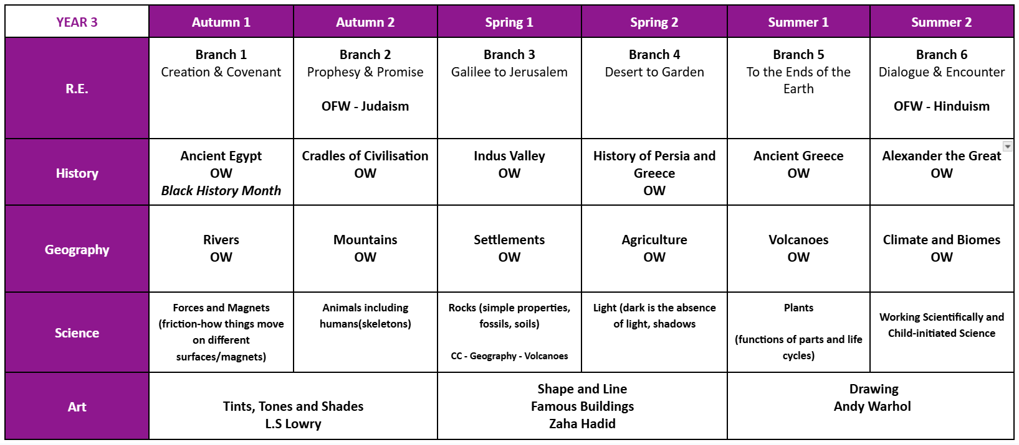
Learning overviews

Slide 6
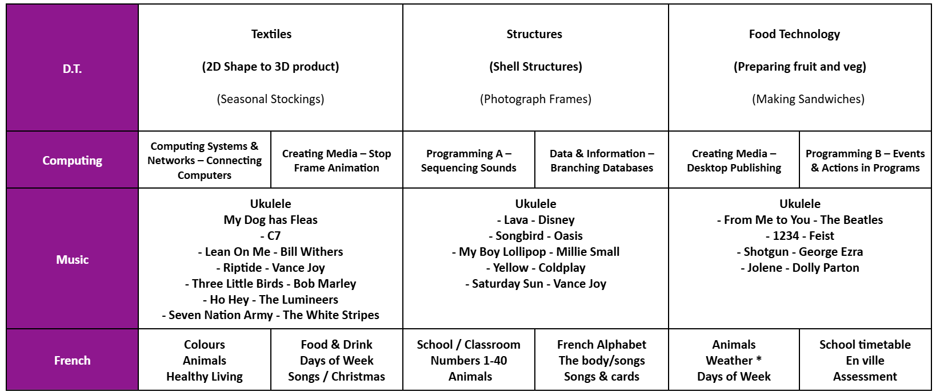
Learning overviews

Slide 7
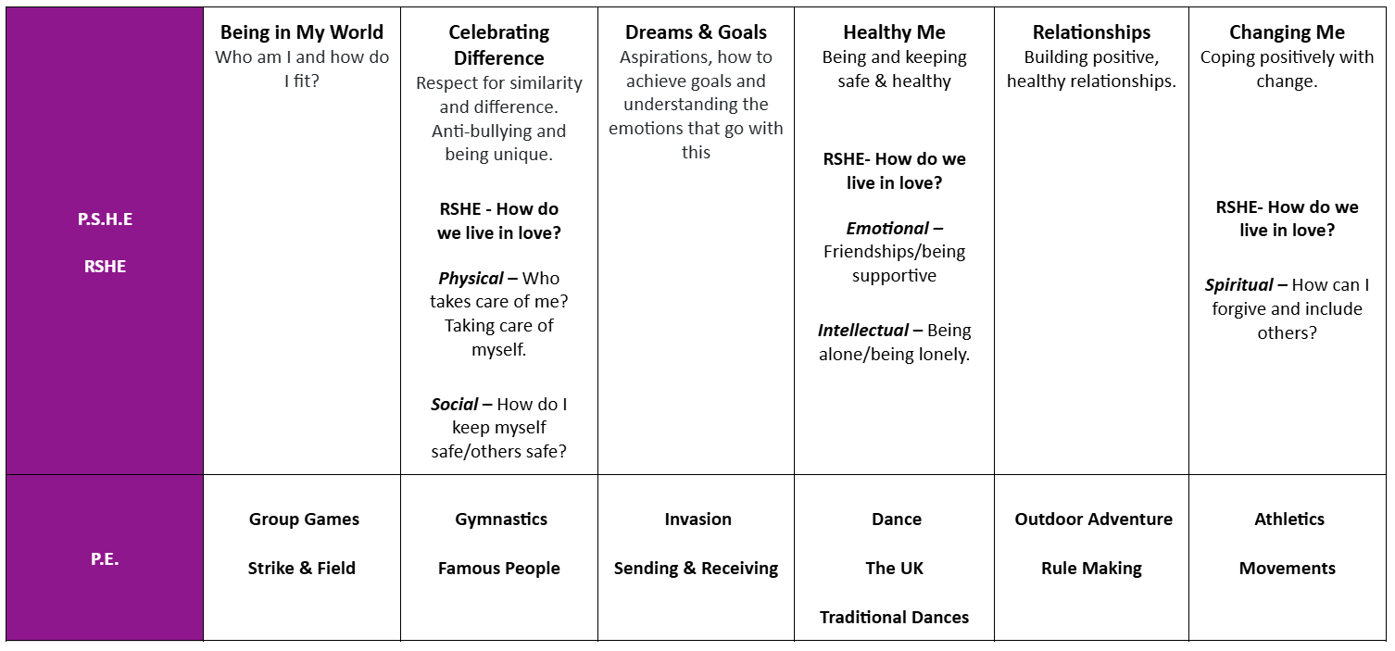
Learning overviews

Slide 8
Curriculum Expectations
Broad and balanced curriculum with high expectations.
We dedicate 10% of our teaching time per week to RE. This is in addition to our daily prayers and Prayer and Liturgy sessions.
Daily English and Maths lessons.
Strong focus on reading and fostering a love of books.
Opportunities for creativity, problem-solving and critical thinking.
Homework set regularly to support class learning.
Children will sit tests on a termly basis. We use the test results in KS2 to determine any additional support required to support our ‘Quality First Teaching’ approach.
All information will be on our website on our class pages and we send out termly knowledge organisers and curriculum maps.

Slide 9
Homework
Homework is as follows:
Spellings and times tables are sent home every Friday.
Reading books are given out for a full week but please ensure that they are sent into school everyday.
Spelling & times table tests are on a Friday.
We are proud to work with Century. Last year we hosted an event with the Metro Mayor for over 200 schools to attend. We know the system works and we can see the impact in results. It is a pioneering initiative Runnymede is at the forefront of.
Our homework system ‘Century’ is an individual programme so please don’t compare to what other parents are saying or what their child is working on.
Century is bespoke – children will not have the same questions as it is an AI generative tool that adjusts to how your child answers a question.
Nuggets will be set by the Class Teacher. Phase Leaders will have oversight of your child’s usage alongside the Class Teacher.

Slide 10
Working Together
Partnership between home and school is key to success.
Encourage your child to talk about their learning at home.
Magna Carta: ALL children who complete the tasks and submit a portfolio of evidence will receive an award at our Annual Prize night
https://www.runnymedestedwards.co.uk/magna-carta/
Support with reading, homework and practising key skills but if your child is tired from their full day of learning please do not put pressure on them.
Attend school events and celebrations where possible.
Together, we create the best opportunities for all children.

Slide 11
Lunches
Our new catering providers ‘Palmer Howells’ offer a wonderful menu. All meals are prepared fresh on site. We will be offering you a taster menu at Parents Evening to see what is on offer. Please take a look at our school website for more information.
However, we would encourage all parents to choose a hot dinner for their child. It is convenient for you and strict nutritional government guidelines are followed by our catering company. School lunches are ‘free’ under the universal free school meal offer for children in Reception to Year 2.
We ask you to talk to your child about the menu choices and we ask you to ensure your child knows how to use a knife and fork correctly!
For children in Year 3-6 you may opt to stay for a ‘Packed Lunch’ and our packed lunch policy must be followed. This is available on our school website.
Please ensure your Arbor account is in credit. Any debt accrued will result in your child no longer being able to stay for a hot dinner.
We ask all families to check if you are eligible for free school meals. As a school we benefit from additional income from the Government!

Slide 12
Sports Teams and Representation
Selection for competitive sports teams is based on ability – we want the best team on the day just as much as all the other schools do who enter these events.
We also enter a number of non-competitive events.
All children will have the chance to represent Runnymede in some capacity over the years they are with us, whether this is at an external event or something hosted here at Runnymede.
Team spirit, resilience and fair play are at the heart of our ethos.
Representation of our school is made hand in hand with behaviour and effort within class.
The Headteacher has the final decision as to who represents the school. All decisions are final.
We celebrate every achievement, big or small!

Slide 13

Find Out More
Visit our school website for more information:
www.runnymedestedwards.co.uk
Thank you for coming!

